Slide 1


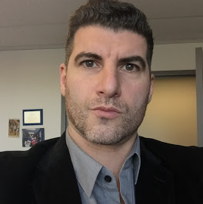


Peter Beens (@pbeens) | Twitter
Anthony Carabache (@HeyCarabache) | Twitter
#OTFCF
OADE @oade14
anthony persaud @games4teaching
OTF/FEO @otffeo
OASPHE @Supportphe
OMCA @OMCAmath
James Steeves @jsteeves71
COPA - English @COPAONLINE
Oaje.org @oaje_org
Barbara Brockmann @BarbaraBrockma1
OESSTA @oessta1
racquel carlow @staopres
Yolanda Navas @navasyh
Sarah Papoff @SarahPapoff
Kate JohnsonMcGregor @TeacherKate
https://goo.gl/Pyu06M

Slide 2
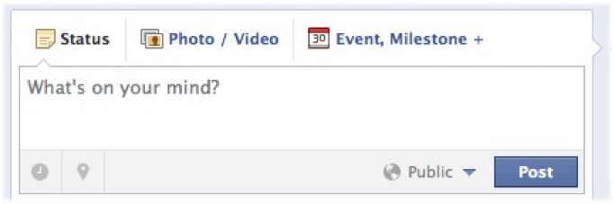
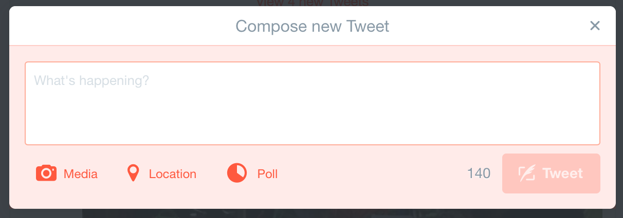
“What’s On Your Mind?”

Slide 3

“It’s not so much about where you are,
As it is about where they are.”

Slide 4

A River of Information - Take Only 3 Cups

Slide 5
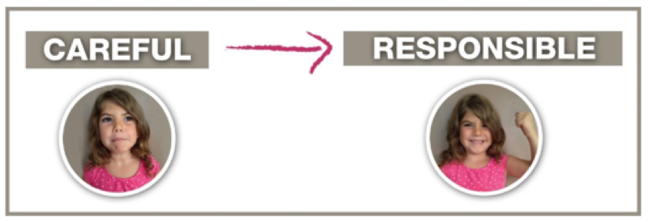
Go to Where They Are:
Overcoming Challenge with One Word

Slide 6
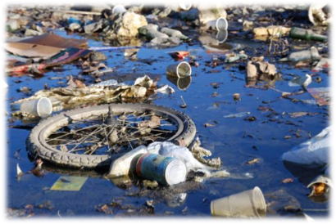



Go to Where They Are

Slide 7
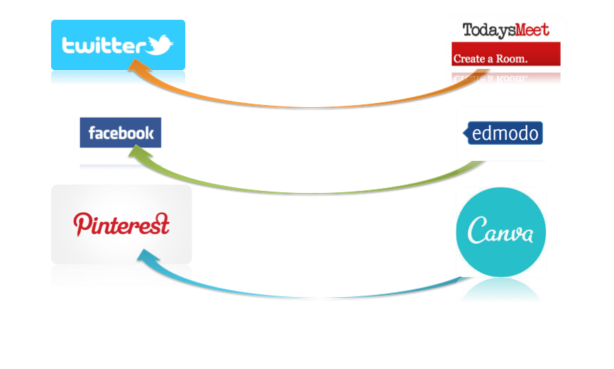
Go to Where They Are

Slide 8
Take My Hand
What are your Goals?
What is your Mission or Motivation?
Identify your Vision Statement
Whose Perspective are you Promoting?

Slide 9
Take My Hand
Take Stock of Your Talents

Slide 10
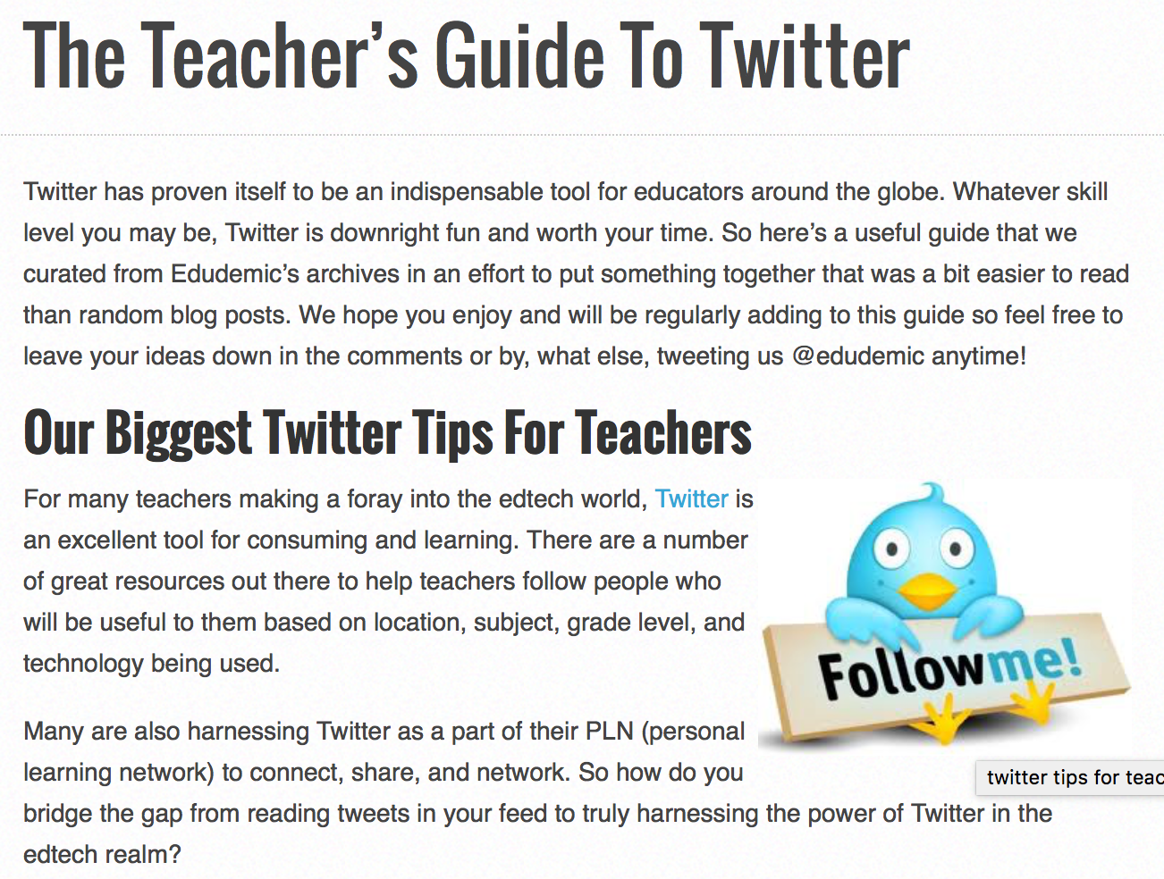

Slide 11

Create, Don’t Just Consume
Share Your Resources
Connect and Network
Keep At It

Slide 12

Phase 1: Consumption

Slide 13

Phase 2: Creation

Slide 14

Phase 3: Connection

Slide 15

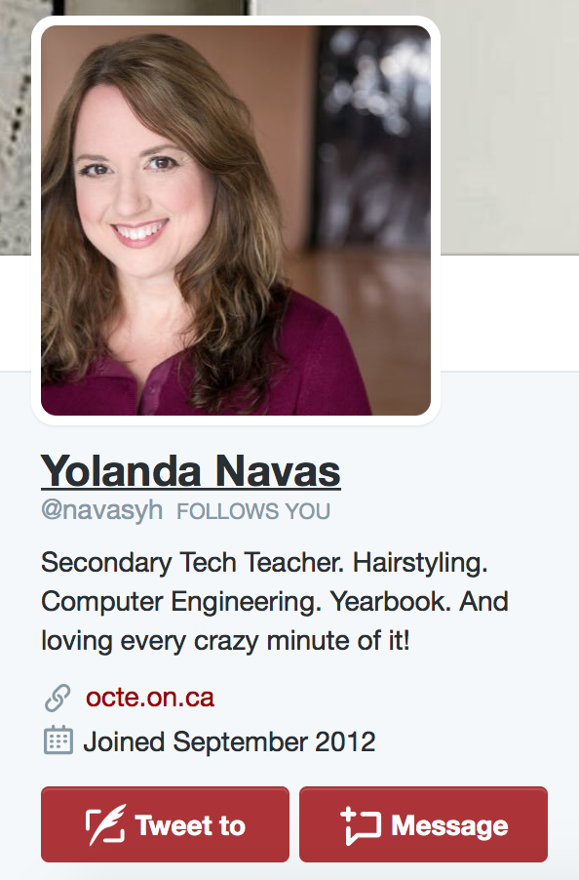
Instagram in Action

Slide 16
Define Purpose:
Promotional/Sharing?
Event Invitations?
Professional Learning? - LISTS & HASHTAGS
Collaboration? (If so - for what purpose?)
Community Expert Connections?
Resource Development?
How about an answer to a question???

Slide 17
Define Measures of Success:
#Followers?
# of Engagements?
# of Retweets?
# of Chats?
Does it lead to a culminating event?
Do you own questionnaires that will measure success?

Slide 18

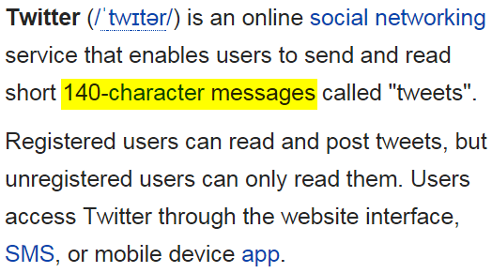

Slide 19
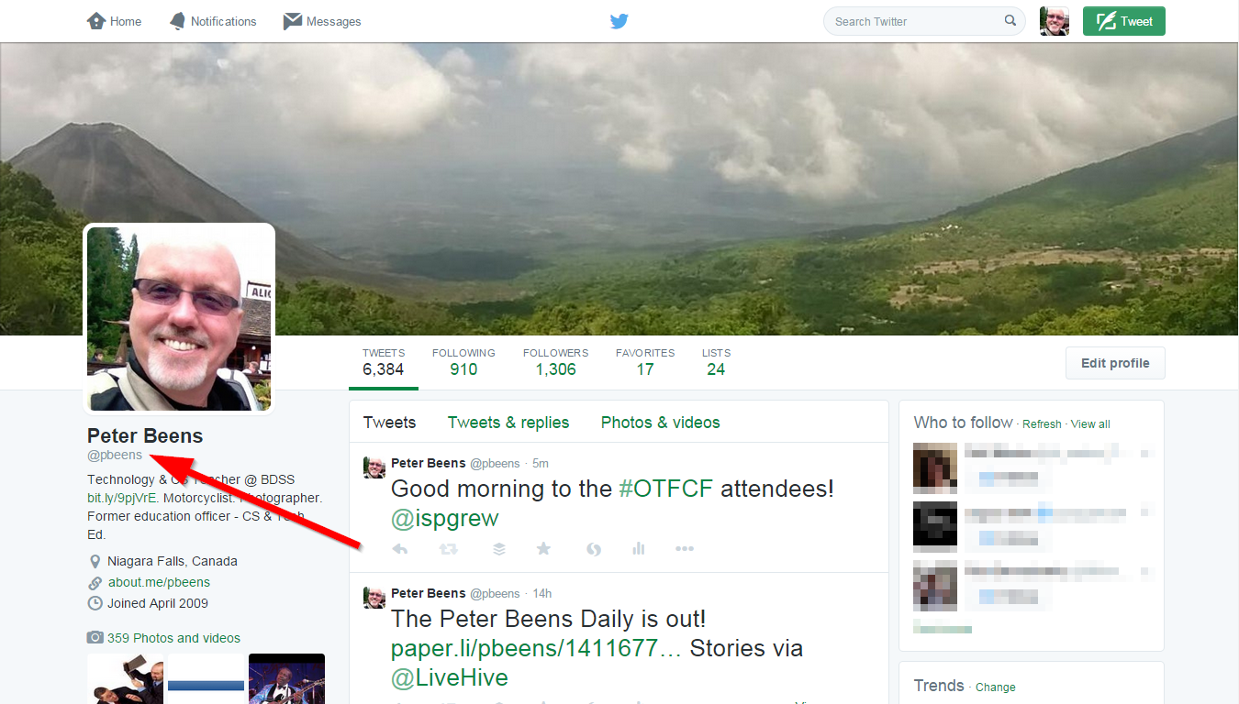
Short username!

Slide 20
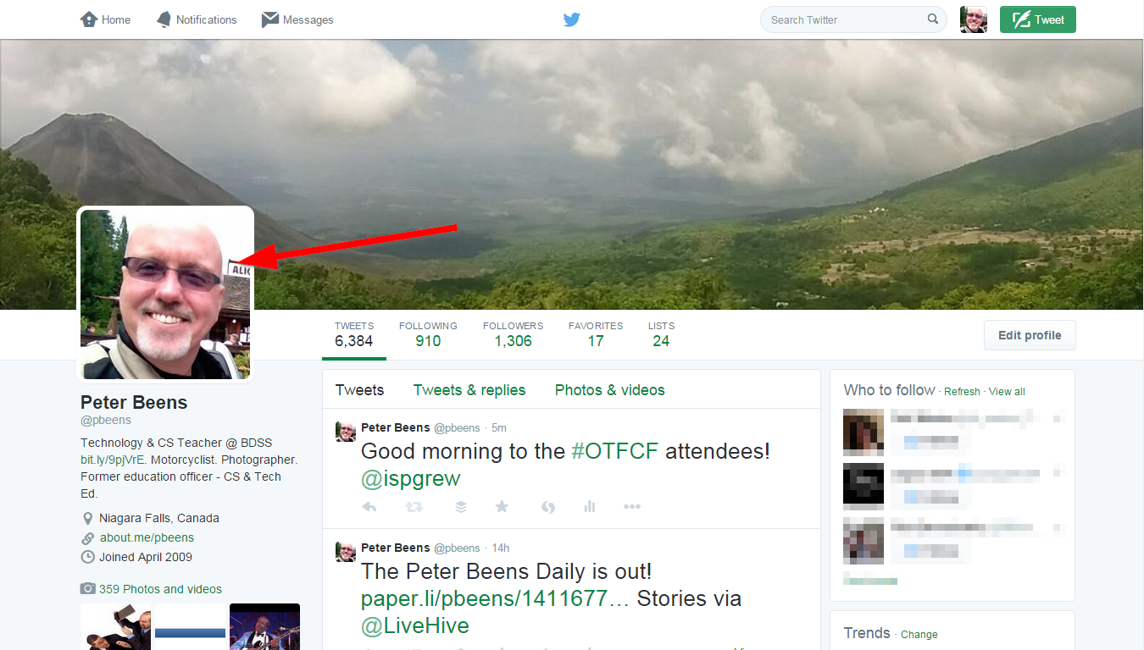
Add a picture!

Slide 21
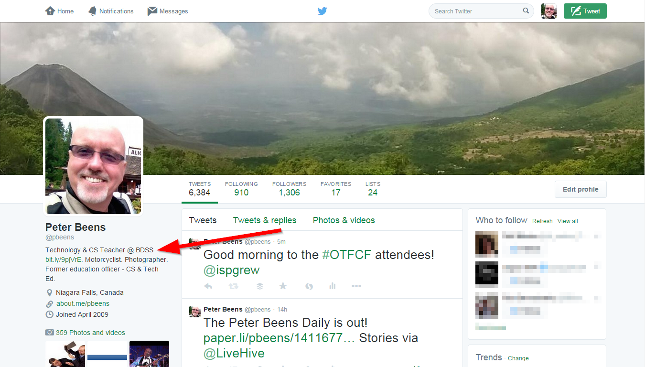
Add a bio!

Slide 22
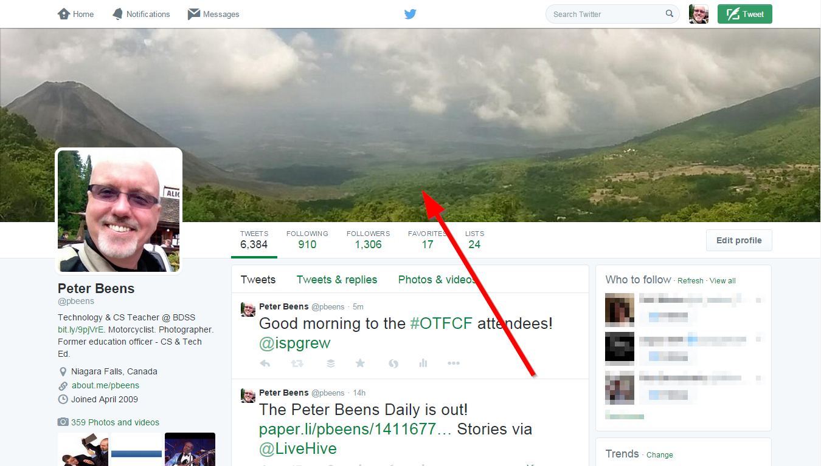
Add a background picture!

Slide 23
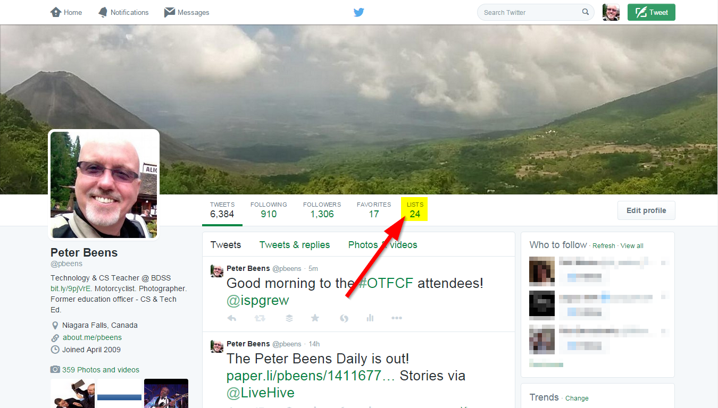
Create lists!

Slide 24
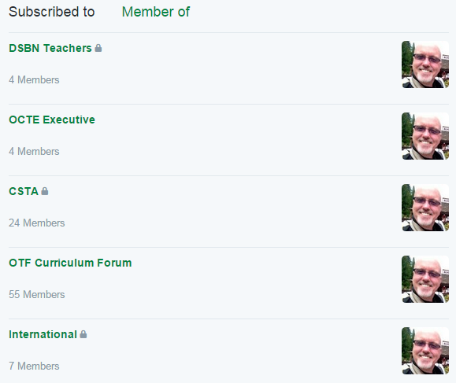
Some of my lists. Some are private and some are public.

Slide 25
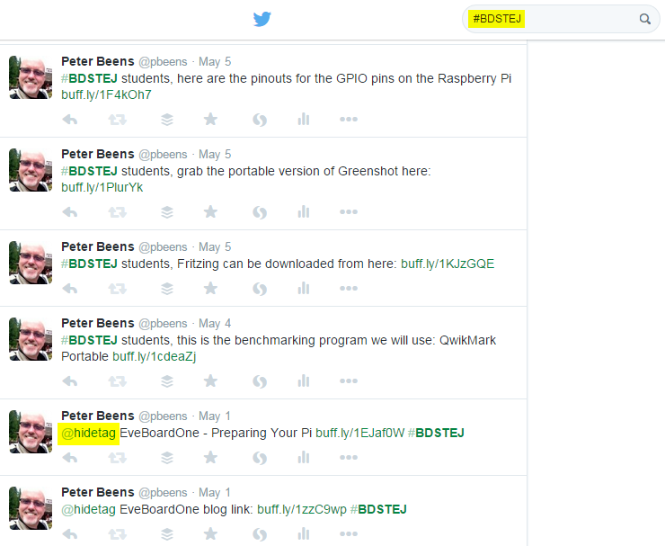
Use a class hashtag

Slide 26
https://twitter.com/pbeens/lists/otf-curriculum-forum
https://goo.gl/cH4IGt
My OTF Curriculum Forum List

Slide 27
Keep tweets short enough they can be retweeted
Put your favourites in a list and bookmark that list
Use a website (or app) such as Hootsuite to make your experience more efficient
Don’t tweet what you ate
Retweet (RT) interesting tweets, but don’t only retweet
Use lists to let you focus on certain users
Use hashtags to focus on certain conversations
#OTFCF
#OntEd
#OnICS
#CSK8
Start small, and put everyone you follow in a private, relevant list
Do not be a complainer
Tweet questions to encourage conversations
Post at the best times (I use Buffer App or https://buffer.com)
Tweet regularly
Some Random Tips

Slide 28
http://lmgtfy.com/?q=Twitter+Tips
http://goo.gl/L0uZXp
If all else fails...

Slide 29
Questions?
(and time for discussion/setup)

Slide 30

No Really… What happened to the # sign?

